Slide 1







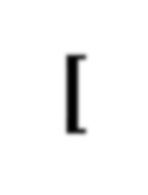
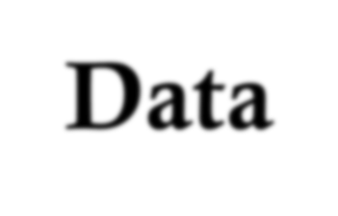
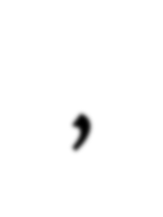
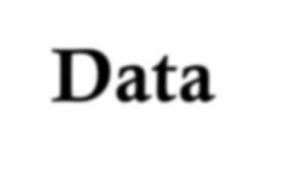
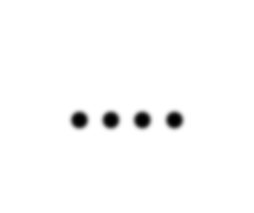
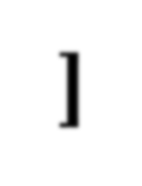
[Data , Data , Data , Data , ….]
1

Slide 2

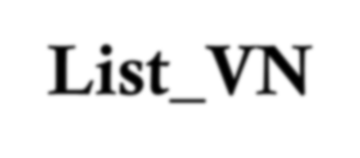
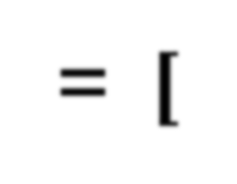




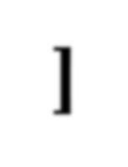





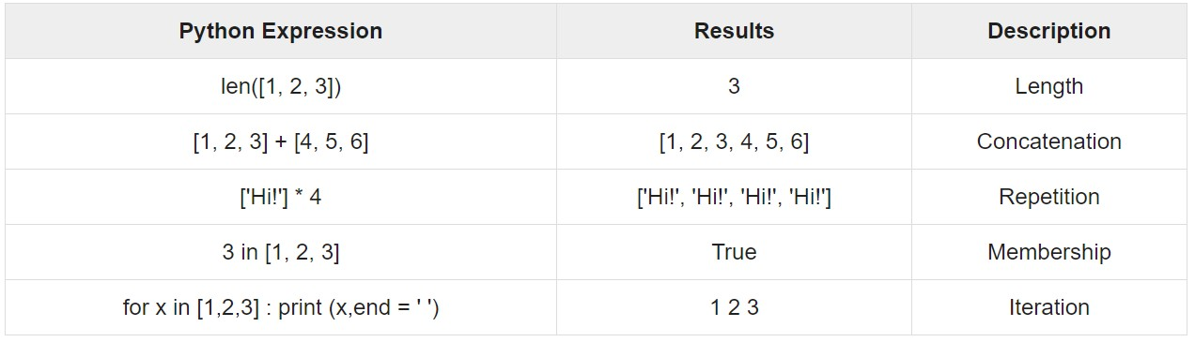
LIST
List_VN= [DATA , DATA , DATA , DATA , ….]
DATA
NUMBER , STRING, FLOAT, TUPLE, LIST, DICTIONARY
1. List=[]
2. List=[1,2]
3. List=[1,2,13.34,16.24]
4. List=[1,2,(1,2,3,4)]
5. List=[1,2,[1,2,3,4]]
6. List=[1,2,13.34,16.2,"Hello!", 'Python!' , "A"]
7. List=[1,2,[1,2,3,4],{1:12,2:"Hi!"}]

Slide 3



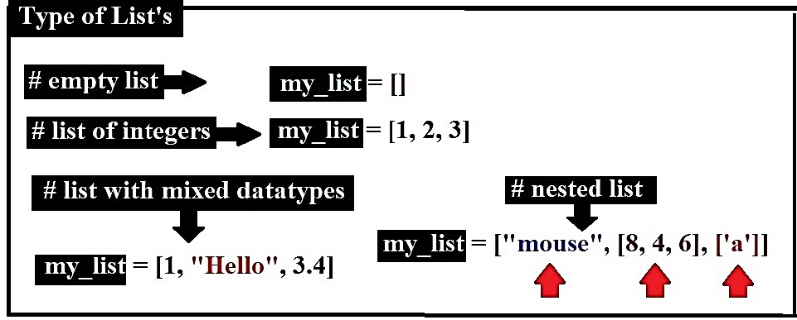
List

Slide 4



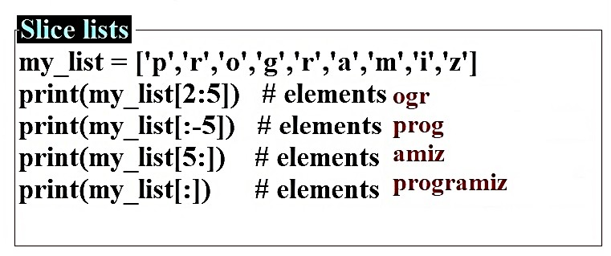
List

Slide 5

















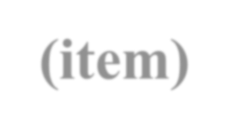





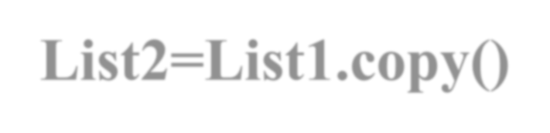
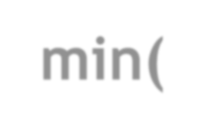








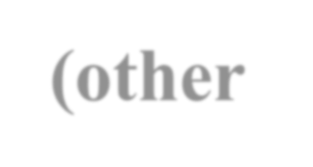


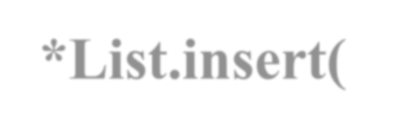


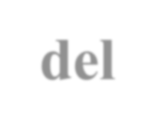

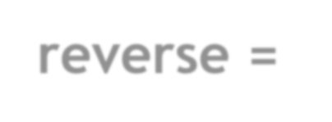
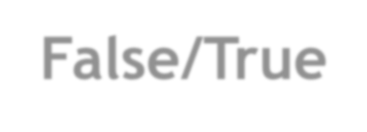


len(List)
List[Index/POS]
List[Start : End] Range
min(List)
max(List)
sorted(List)
List.sort(reverse = False/True)
List.reverse()
List.pop(Index/POS)
List.remove(item)
List2=List1.copy()
*List.append(Item/LIST) in END
*List.extend(other LIST)
*List.insert( POS, Item)
del List [POS/Index/Range like[Start : End]]

Slide 6




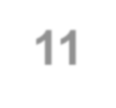








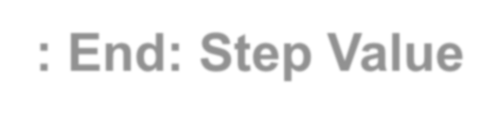

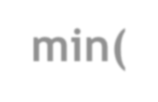
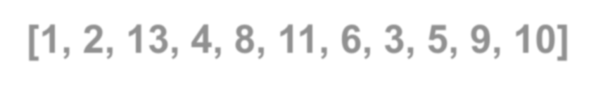
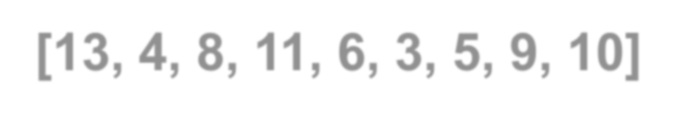

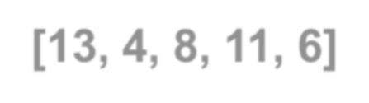

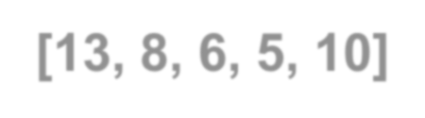
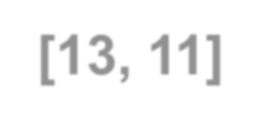
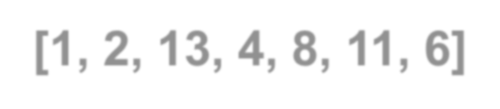
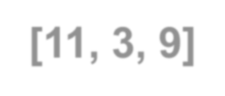
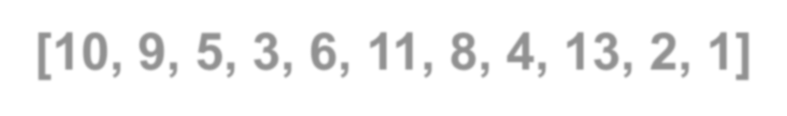
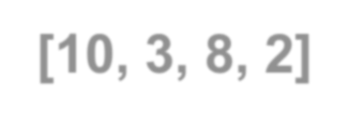


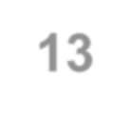
List=[1,2,13,4,8,11,6,3,5,9,10]
len(List) List[Index/POS] List[Start : End]
List[Start : End: Step Value]
min(List) max(List)
1. print(len(List)) 11
##List[Index/POS] |List[Start : End] |List[Start : End: Step Value]
print(List[0])
print(List[5])
print(List[:])
print(List[2:])
print(List[2:7])
print(List[::])
print(List[2::2])
print(List[2:7:3])
print(List[:7:])
1
11
[1, 2, 13, 4, 8, 11, 6, 3, 5, 9, 10]
[13, 4, 8, 11, 6, 3, 5, 9, 10]
[13, 4, 8, 11, 6]
[1, 2, 13, 4, 8, 11, 6, 3, 5, 9, 10]
[13, 8, 6, 5, 10]
[13, 11]
[1, 2, 13, 4, 8, 11, 6]
[11, 3, 9]
[10, 9, 5, 3, 6, 11, 8, 4, 13, 2, 1]
[10, 3, 8, 2]
print(List[5::2])
print(List[::-1])
print(List[::-3])
##min(List)
1. print(min(List)) 1
##max(List)
1. print(max(List)) 13

Slide 7


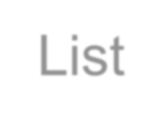


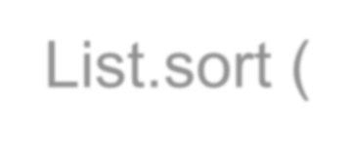
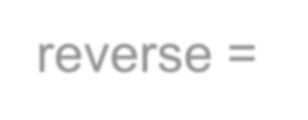
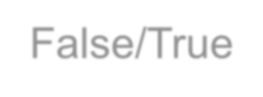
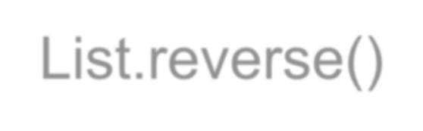

sorted(List) #temp List.sort (reverse = False/True) List.reverse()
List=[1,2,13,4,8,11,6,3,5,9,10]
print(sorted(List)) [1, 2, 3, 4, 5, 6, 8, 9, 10, 11, 13]
List=[1,2,13,4,8,11,6,3,5,9,10]
List.sort ()
print(List) [1, 2, 3, 4, 5, 6, 8, 9, 10, 11, 13]
List=[1,2,13,4,8,11,6,3,5,9,10]
List.sort (reverse=False)
print(List) [1, 2, 3, 4, 5, 6, 8, 9, 10, 11, 13]
List=[1,2,13,4,8,11,6,3,5,9,10]
List.sort(reverse =True)
print(List) [13, 11, 10, 9, 8, 6, 5, 4, 3, 2, 1]
List=[1,2,13,4,8,11,6,3,5,9,10]
List.reverse()
print(List) [10, 9, 5, 3, 6, 11, 8, 4, 13, 2, 1]

Slide 8

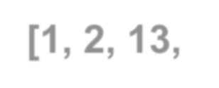

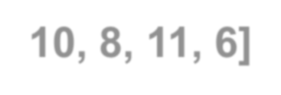






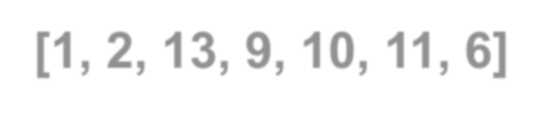


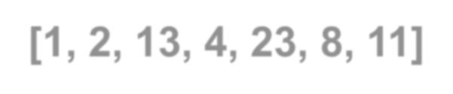

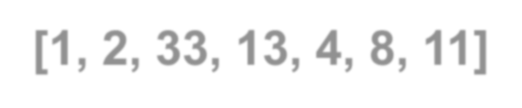
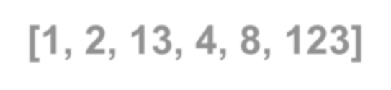
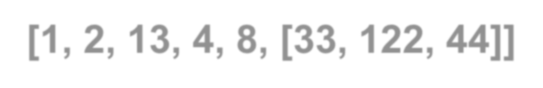
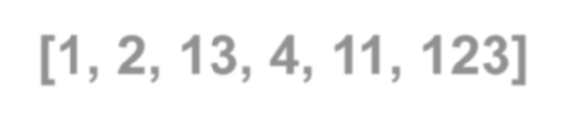
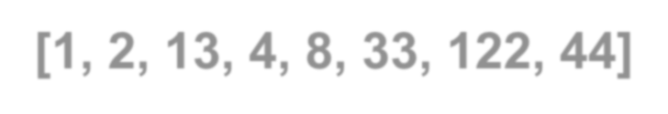
List=[1,2,13,4,8,11,6]
List[3]=-10
print(List) [1, 2, 13, -10, 8, 11, 6]
List=[1,2,13,4,8,11,6]
List[3:5]=[9,10]
print(List) [1, 2, 13, 9, 10, 11, 6]
##List.append(Item/LIST) in END List=[1,2,13,4,8]
List.append(123)
print(List) [1, 2, 13, 4, 8, 123] List=[1,2,13,4,8]
List.append([33,122,44])
##List.insert( POS/LOC, Item) List=[1,2,13,4,8,11]
List.insert(-2,23)
List.append(Item/LIST) List.extend (other LIST) List.insert( POS, Item)
print(List)
[1, 2, 13, 4, 23, 8, 11]
List=[1,2,13,4,8,11]
List.insert(2,33)
print(List)
[1, 2, 33, 13, 4, 8, 11]
print(List) [1, 2, 13, 4, 8, [33, 122, 44]]
##List.extend(other LIST)
List=[1,2,13,4,11]
List.extend([123])
print(List) [1, 2, 13, 4, 11, 123] List=[1,2,13,4,8]
List.extend([33,122,44])
print(List) [1, 2, 13, 4, 8, 33, 122, 44]

Slide 9


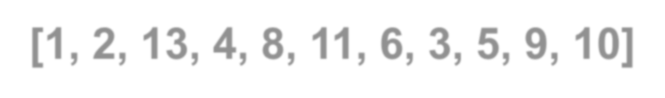




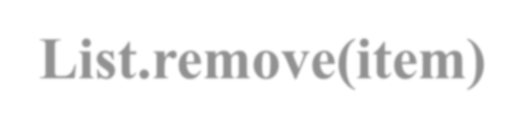
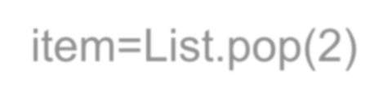



























List=[1,2,13,4,8,11,6,3,5,9,10]
print(List) [1, 2, 13, 4, 8, 11, 6, 3, 5, 9, 10]
List.pop(Index/POS)
List.remove(item)
del List [POS |Index |Range like:[Start : End]]
List.clear()
##List.pop(Index/POS) item=List.pop(2)
print(item) 13
item=List.pop(-2)
print(item)
print(List)
9
[1, 2, 4, 8, 11, 6, 3, 5, 10]
##List.remove(item) List=[1,2,13,4,8,11,6,3,5,9,10]
List.remove(2)
print(List) [1, 13, 4, 8, 11, 6, 3, 5, 9, 10]
List.remove(11)
print(List) [1, 13, 4, 8, 6, 3, 5, 9, 10]
List.remove(2) #print(List) #Error
##del List [POS/Index/Range like[Start : End]] List=[1,2,13,4,8,11,6,3,5,9,10]
del List
#print(List) #Error: 'List' is not defined
9

Slide 10






























List.pop(Index/POS) List.remove(item) del List
List=[1,2,13,4,8,11,6,3,5,9,10]
del List[2:6]
print(List) [1, 2, 6, 3, 5, 9, 10]
List=[1,2,13,4,8,11,6,3,5,9,10]
del List[:]
##list.clear() All item's deleted
List=[1,2,13,4,8,10,19,5,3]
del List
#print(List)
#Error: 'List' is not defined
List=[1,2,13,4,8,10,19,5,3]
List.clear()
[POS/Index/Range like[Start : End]]
List.clear()
print(List) []
List=[1,2,13,4,8,11,6,3,5,9,10]
del List[3:]
print(List) [1, 2, 13]
List=[1,2,13,4,8,11,6,3,5,9,10]
del List[:3]
print(List) []
print(List) [4, 8, 11, 6, 3, 5, 9, 10]
List=[1,2,13,4,8,11,6,3,5,9,10]
del List[::2]
print(List) [2, 4, 11, 3, 9]
List=[1,2,13,4,8,11,6,3,5,9,10]
del List[4::2]
print(List) [1, 2, 13, 4, 11, 3, 9]
10

Slide 11


























List2=List1.copy()
List1=[1,2,13,4]
List2=List1
List1=[1,2,13,4]
List2=List1.copy()
[1, 2, 13, 4]
[1, 2, 13, 4]
[1, 2, 13, 4, 9]
[1, 2, 13, 4]
List1=[1,2,13,4]
List2=List1.copy()
[1, 2, 13, 4]
[1, 2, 13, 4]
[1, 2, 13, 4]
[1, 2, 13, 4, 9]
print(List1) print(List2) List1[2]=-3
print(List1)
print(List2)
[1, 2, 13, 4]
[1, 2, 13, 4]
print(List1) print(List2)
List1.append(9)
[1, 2, -3, 4]
[1, 2, -3, 4]
print(List1)
print(List2)
List1=[1,2,13,4]
List2=List1 List2[-1]=9
print(List1)
print(List2)
print(List1) print(List2)
[1, 2, 13, 9]
[1, 2, 13, 9]
List2.append(9)
print(List1) print(List2)
11

Slide 12













NL=[[3,1,7,4],[5,2,7,1],[11,3,16,9]]
print(NL) [[3, 1, 7, 4], [5, 2, 7, 1], [11, 3, 16, 9]]
Enter List Size: : 5 List Item : 1: 12
List Item : 2: 32
List Item : 3: 33
List Item : 4: 45
List Item : 5: 10
[12, 32, 33, 45, 10]
NL[0].sort()
NL[1].sort()
NL[2].sort()
print(NL) [[1, 3, 4, 7], [1, 2, 5, 7], [3, 9, 11, 16]]
List=[]
N=int(input("Enter List Size: ")) for i in range(N):
List.append(int(input("List Item : %d: "%(i+1))))
print(List)
List=[]
N=int(input("Enter Nested List Size: ")) M=int(input("Enter Item Size in Each Data Item: ")) for i in range(N):
Data=[]
for j in range(M):
item=int(input("List Item : %d:%d : "%(i+1,j+1))) Data.append (item)
List.append(Data)
print(List)
NL=[[3,1,7,4],[5,2,7,1],[11,3,16,9]]
for i in range(len(NL)): NL[i].sort()
print(NL) [[1, 3, 4, 7], [1, 2, 5, 7], [3, 9, 11, 16]]
Enter Nested List Size: 2
Enter Item Size in Each Data Item: 3 List Item : 1:1 : 11
List Item : 1:2 : 25
List Item : 1:3 : 14
List Item : 2:1 : 21
List Item : 2:2 : 22
List Item : 2:3 : 26
[[11, 25, 14], [21, 22, 26]]
12

Slide 13








#List Creation using for Loop
List = []
for letter in 'PYTHON': List.append(letter)
print(List) ['P', 'Y', 'T', 'H', 'O', 'N']
#List Creation using while Loop
List = [] s,i="PYTHON",0
while i<len(s): List.append(s[i]) i+=1
print(List) ['P', 'Y', 'T', 'H', 'O', 'N']
#List Comprehension
List = [letter for letter in 'PYTHON'] print(List) ['P', 'Y', 'T', 'H', 'O', 'N']
#List Creation using Lambda functions
List = list(map(lambda letter: letter, 'PYTHON'))
print(List)
['P', 'Y', 'T', 'H', 'O', 'N']
#Conditionals in List Comprehension List = [ a for a in range(15) if a % 2 != 0]
print(List)
[1, 3, 5, 7, 9, 11, 13]
#Nested IF with List Comprehension
List = [a for a in range(30) if a % 2 == 0 if a % 5 == 0]
print(List)
[0, 10, 20]
#if...else With List Comprehension
List = ["Even %d"%i if i%2==0 else "Odd %d"%i for i in range(5)]
print(List)
['Even 0', 'Odd 1', 'Even 2', 'Odd 3', 'Even 4']
13

Slide 14




Question 4
L=[5,8,5,9,2,5,7]
print(L) L.append(4) L.remove(5) L.insert(4,-8) L.pop(2)
L.insert(1,7) print(L) L.pop(3) L.remove(7) print(L) L.append(23) print(L) L.append(12) L.pop(1)
L.pop(4) print(L)
Question 5
animal = ['cat', 'dog', 'rabbit'] print(animal) animal.append('pig') animal.append('rat') print(animal)
wild_animal = ['tiger', 'fox'] print( wild_animal) animal.append( wild_animal) print(animal) animal.remove('pig') animal.insert (2,'Zebra') animal.pop(1) animal.insert(0,'Giraffe') print(animal)
animal.pop(1) animal.pop(4) print(animal)
Question 1 | Question 2 | Question 3
L=[12,32,33] | L=[1,2,3,4,5] | L=[5,8,5,9,2,7]
print(L) | print(L) | print(L)
L.append(9) | L.append(1) | L.append(11)
L.insert (2,6) | L.insert(3,8) | L.insert(4,-8)
L.pop(2) | L.pop(4) | L.pop(2)
L.insert(1,43) | L.insert(1,-4) | L.insert(1,-4)
print(L) | print(L) | print(L)
L.reverse() | L.sort() | L.sort()
print(L) | print(L) | print(L)
L.append(5) | L.append(-7) | L.append(-11)
L.remove(9) | L.remove(2) | L.remove(5)
print(L) | print(L) | print(L)
L.append(2) | L.append(12) | L.append(12)
L.pop(-2) | L.pop(-3) | L.pop(1)
print(L) | print(L) | print(L)
14

Slide 15



WAP count -ve and +ve item in list items.
WAP to display sum of all items of list.
WAP display square of all items of list.
WAP square and display all items of list.
WAP to display multiplication of all items of list.
WAP to find even / odd items in list.
WAP to count even / odd items in list.
LIST
Programs
WAP to display sum of all even and odd items of list.
WAP to replace all even by 0 and odd by 1 in list items
10.WAP to find / count an item in an list items
WAP to replace an item by other item in an list.
WAP to Find(display) / Count / Add all prime numbers in list items
WAP to replace all prime numbers by 0 in list items.
WAP to find an item in a list by linear search. 15.WAP to find an item in a list by binary search. 16.WAP to display the sorted list(integer items). 17.WAP to display the sorted list(String items).
18.WAP to display the sort list(String) items length wise. 19.WAP to display in reverse of list.
WAP to reverse all items of list and then display.
WAP to display highest and lowest item (integer) from list. 22.WAP to input 10 integers in list and display smallest & largest
23.WAP to input 10 integers in list and display those numbers which end with 0(zero).
15

Slide 16





1. Consider the following list:
monuments=[ 'Kutub Minar', 10, 'Taj Mahal', 20, 'India Gate', 30, 'Char Minar', 40] states=['Delhi', 'Kerala', 'Tamil Nadu', 'Bihar']
Write Python statements for the following:
LIST
To insert “Red Fort” at index number 5
To add 50 at the end of the list
To add list states at the end of the list monuments
To replace 3rd, 4th and 5th element of the monuments list by “India”.
To remove the third element from the list monuments.
To delete 3rd to 5th elements from the list monuments.
To display the index number of the element “Kerala” from the states list.
To check whether the element 20 is present in the list or not.
2. Consider the lists languages and states and give the output of the following Python statements: languages=['Hindi', 'English', 'Bengali', 'Oriya', 'Telugu', 'Marathi', 'Malayalam']
states=['Delhi', 'Kerala', 'Tamil Nadu', 'Bihar', 'Delhi']
languages=languages + ”Tamil”
states=states*2
len(languages)
max(languages)
min(languages)
count(‘Delhi’)
Programs
Write Python script to display the element with maximum value from the given list.
Write Python script to display the element with minimum value from the given list.
Write Python script to display the sum of elements from the given list of numbers.
Write Python script to display the average of elements from the given list of numbers.
Writ a Python script to input a list of numbers and a number. Check whether the given number is present in the list or not.
Write a Python script to input a list and find all duplicates and display number of times they are present in the list.
16

